Slide 1







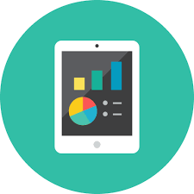


DATA AGGREGATION & MONITORING
WITH PROMETHEUS
Pravin M J
Software developer

Slide 2






SESSION ROADMAP
Problem
Statement
Overview
Prometheus
Architecture
Benefits
Solutions
About Prometheus
Time-series ?
Why it’s needed?
How it Works?
Features & Data Model
Base Architecture
& its
Components
Benefits
Shortcomings
Alternatives
Current Problem Statements within services
With Prometheus &
Future Road Map

Slide 3







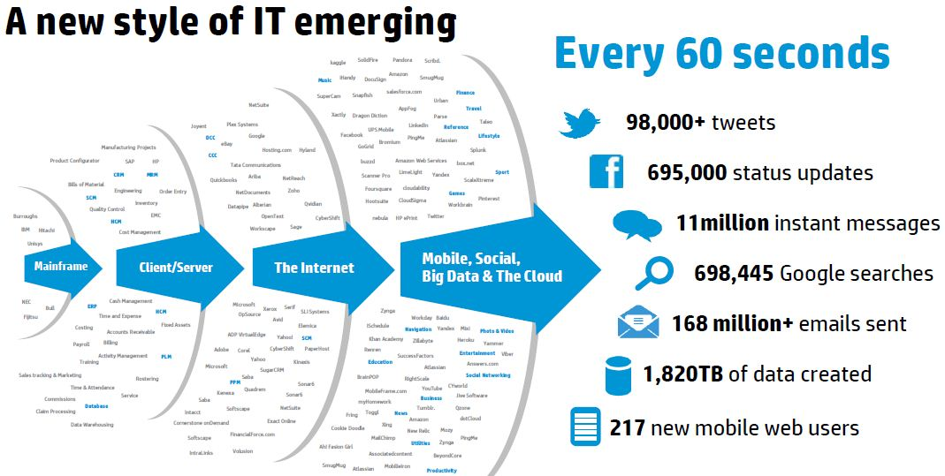
Why The Buzz??
Cloud & Distributed System
Containers/Serverless
Mobile/Networking
Security
IoT - Data Generation Rate

Slide 4




What is Prometheus?
Open source monitoring and alerting tool (SoundCloud/CNCF)
Highly dynamic container environments
Stores data in Time-series model
Bare Metal Servers
Container Cluster
My-App
My-DB
My-App
My-DB

Slide 5
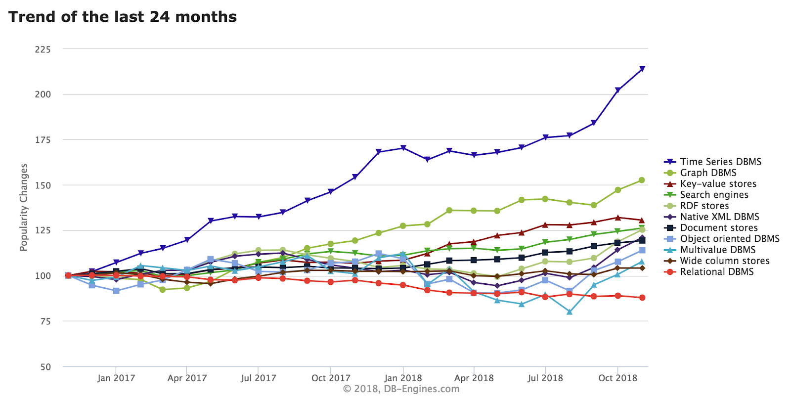
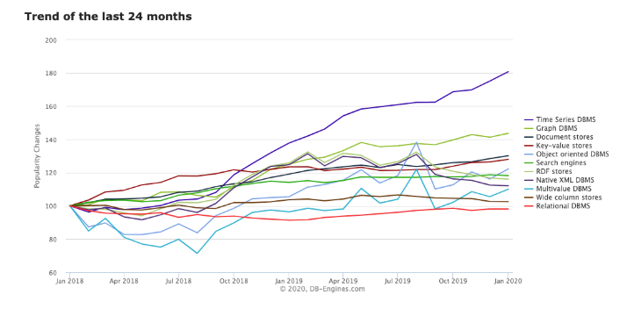




What is Time Series Database?
A Database optimized to store timestamped data
Events that are tracked, monitored, downsampled and aggregated over time
Server metrics, Application performance monitoring, network monitoring, sensor data, events, clicks, trades in market...

Slide 6
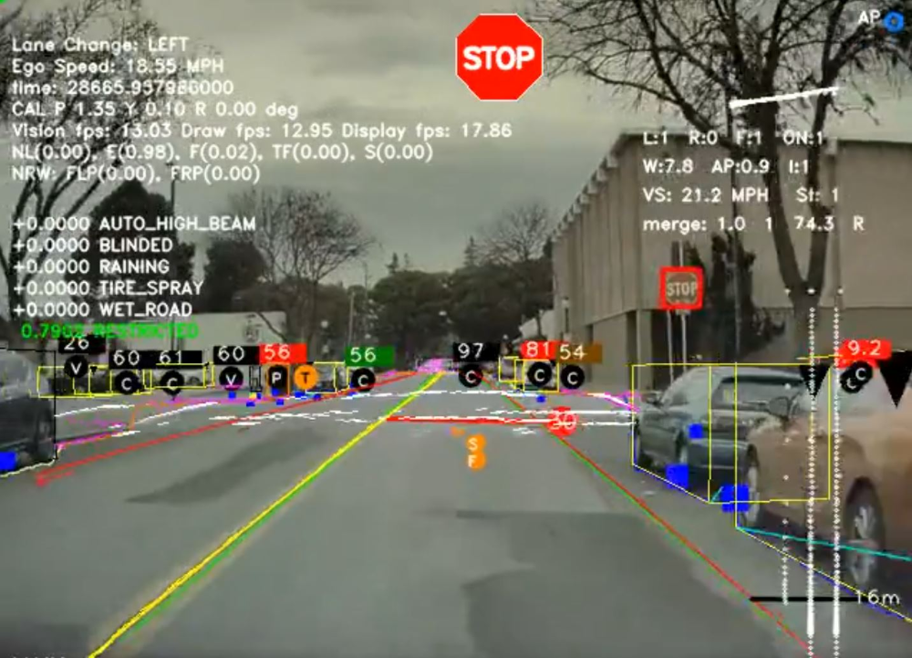


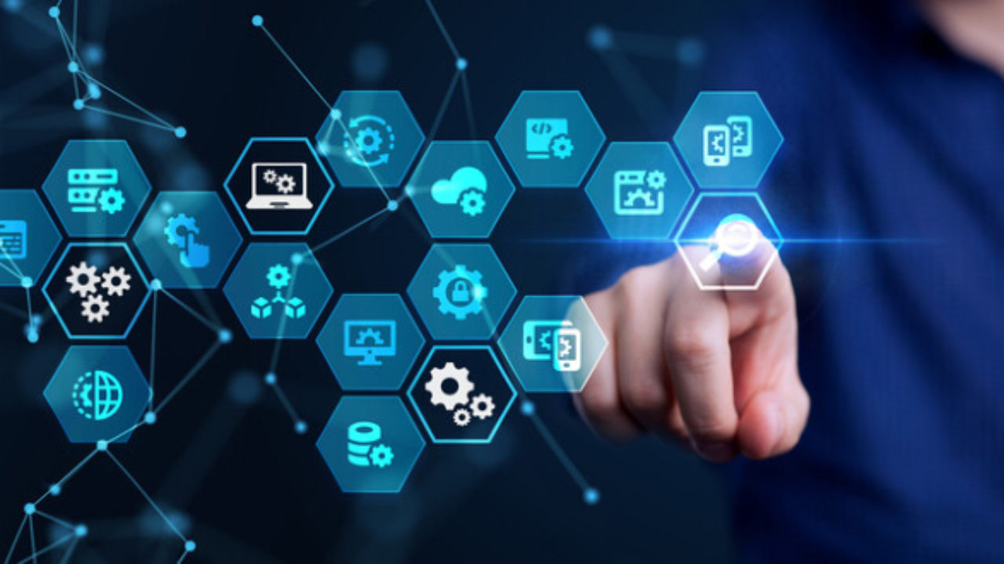
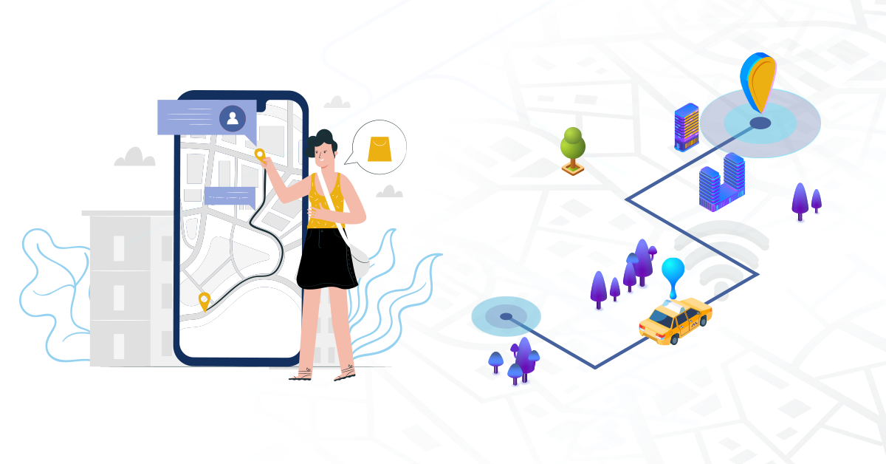
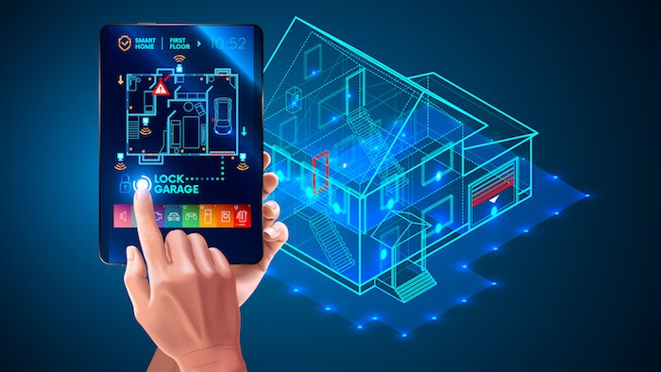
What is Time Series Database?
A Database optimized to store timestamped data
Self Driving cars
Retail Industry
Events that are tracked, monitored, downsampled and aggregated over time
Trading Algorithm
DevOps
NYPD/Transport
Smart Homes

Slide 7

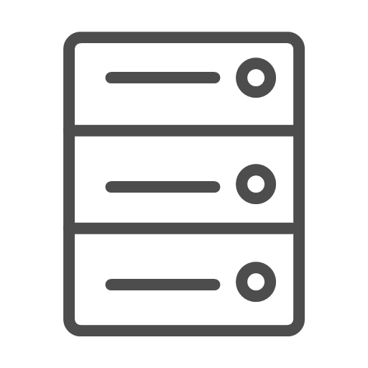
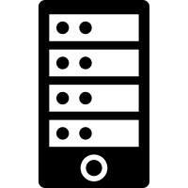

Why it's Needed?
Monitoring has become complex.
100s of process
Interconnected
Response Latency
Errors
Overloaded
Hardware ?
Application ?
Enough Resources
Database ?

Slide 8

How it Works?
Prometheus Web UI
Apps,
DB
Retrieval
Pulls Metric Data
Storage
Stores metric data
HTTP Server
Accepts Queries
Servers, Services
Data Retrieval Worker
Time-series Database
Accepts PromQL Queries

Slide 9
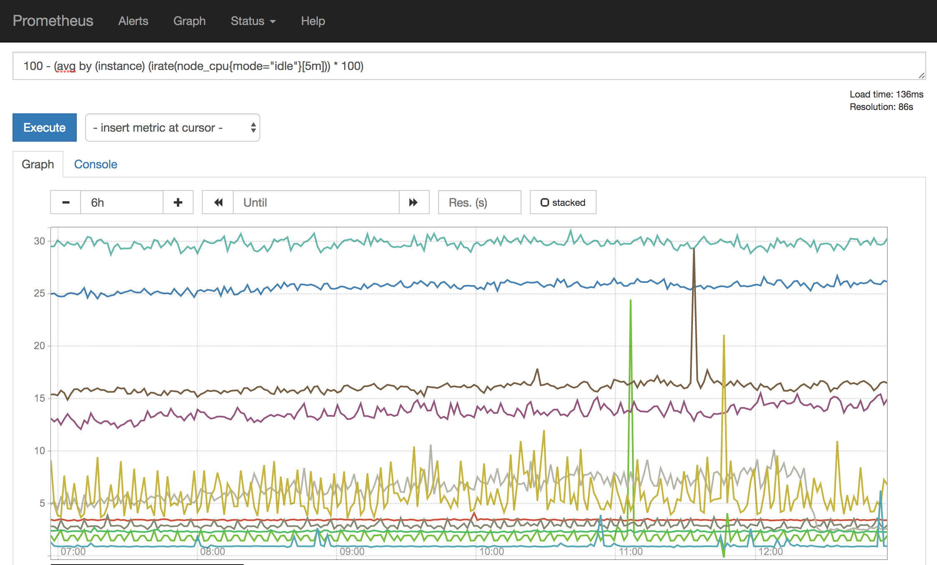
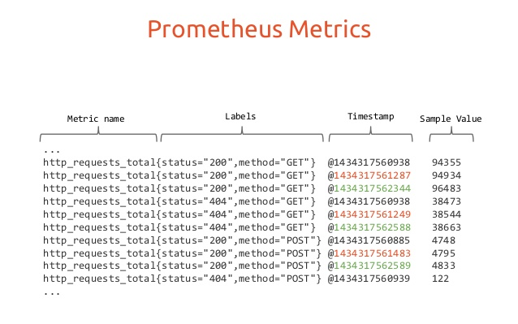
Features & Data Model
Multidimensional data model, identified by metric and key,value pair
Data Extraction with pull mode over HTTP
Service Discovery/Static configs
Inbuilt Dashboard
PromQL
100 - (avg by (instance)
(irate(node_cpu_seconds_total{job=”node”,mode=”idle”}
[5m]))*100)

Slide 10
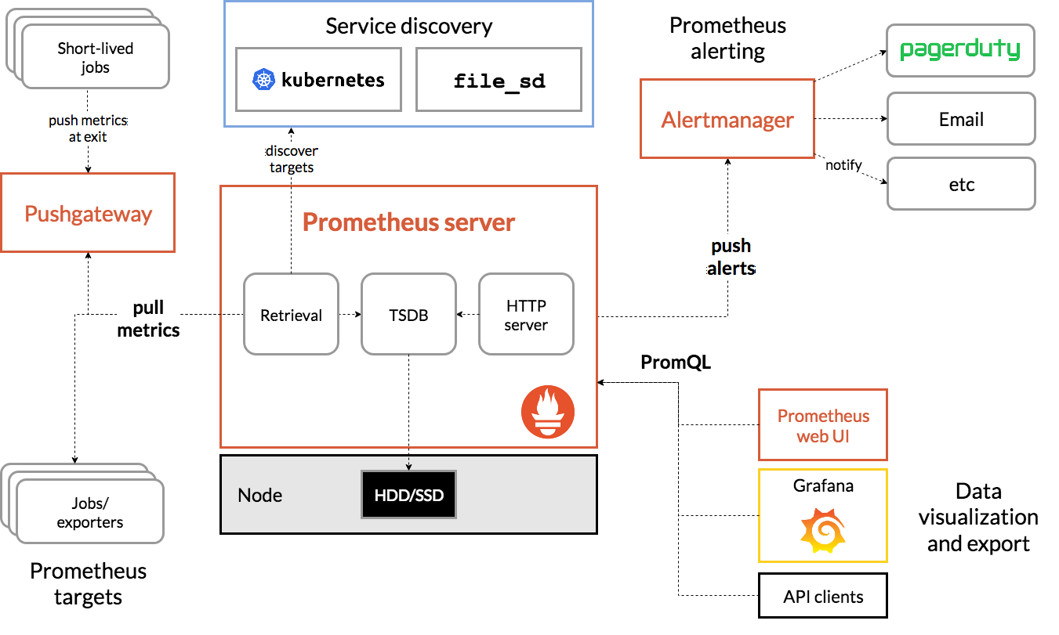
Architecture & Exporters
Prometheus Server
Prometheus Server
Scrapes and Stores time series data
Scrapes and Stores time series data
Push Gateway
Push Gateway
For Short Lived Jobs (Emails, Cron, push notifications)
For Short Lived Jobs (Emails, Cron, push notifications)
Exporters
Exporters
Export Metrics from 3rd party systems
Export Metrics from 3rd party systems
Alert Manager
Alert Manager
Service Discovery
Service Discovery
Visualization
Visualization
Handle and tracks alerts
Handle and tracks alerts
Automatically scrap metrics
Automatically scrap metrics
WebUI/Grafana
WebUI/Grafana

Slide 11
Architecture & Exporters
Database Exporters
MySQL,MongoDB,Redis,
Postgres
Hardware Related
Netgear Router, NVIDIA GPU
Issue Tracker/CI
JIRA, Jenkins
Messaging Systems
RabbitMQ, Kafka
Storage
Ceph, Gluster, hadoop
HTTP
Apache, Nginx VTS
API
AWS. DO. Azure Health, GitHub, Gmail
Others..
Alibaba, Bitcoin, CAdvisor. JSON, Nagios. OpenStack..,
250 + Exporters

Slide 12
Targets
Metrics
Linux/
Windows Server
CPU Status
Memory/
Disk Space Usage
Web Servers
Apache,
Nginx
Request Counts
Single
Apps
Exception Counts
Database Services
Request Duration

Slide 13
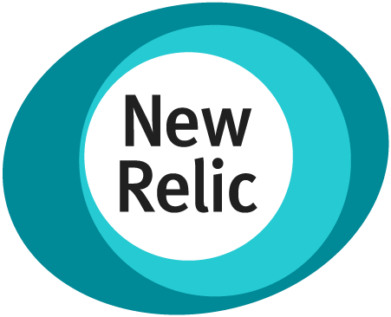





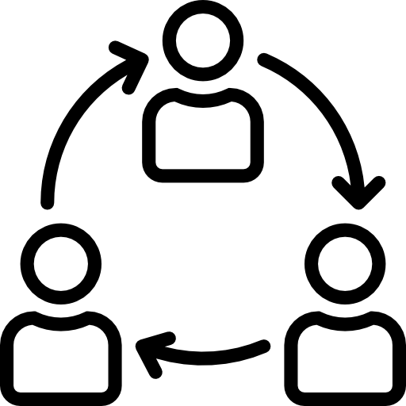



Benefits
Shortcomings
Others
Time-series Optimized
Pull based metrics
One Service to rule all
Centralized Control
Inbuilt Alerting
Service Discovery
Limited Scalability
DSL
Service Maintenance
Needed Secure Network Configuration
Does not Store raw text, but only numerics
>>> Logs <<<
Faster Recovery (MTTR)
Better
Quality
Reduced Maintenance
Improved
Productivity

Slide 14


The Problem Statement To be Continued with next session
Monitor Infrastructure and Nodes? - App servers, Web servers, Databases, Caches, Message Queues, Networks calls, API calls..
Redis Wannamine
Resource Overload
How an error is identified?
How node failure or resource outage is identified?
Smart meter failure
Parse Logs
Analysis/History of Logs?
Wait Until it occurs Again…..
Expected Downtime/MTTR?
Wait Until it occurs Again…..

Slide 15
The Solution To be Continued with next session
Network Related monitoring (Web servers)
Database exporters
Long term log storage
On demand Admin Dashboards
More IoT..
Future RoadMap
Centralized Monitoring
CPU, Memory Usage,
Disk Usage..With Prometheus &
Node Exporter
Store Smart-meter logs in Loki.
Ship, Analyse and Filter logs easily
Log Aggregation and Analysis
Visualize in Real Time
Created dynamic and highly customizable dashboards
with available data set
Notify in microsoft teams
Alert and Notify on issue

Slide 16
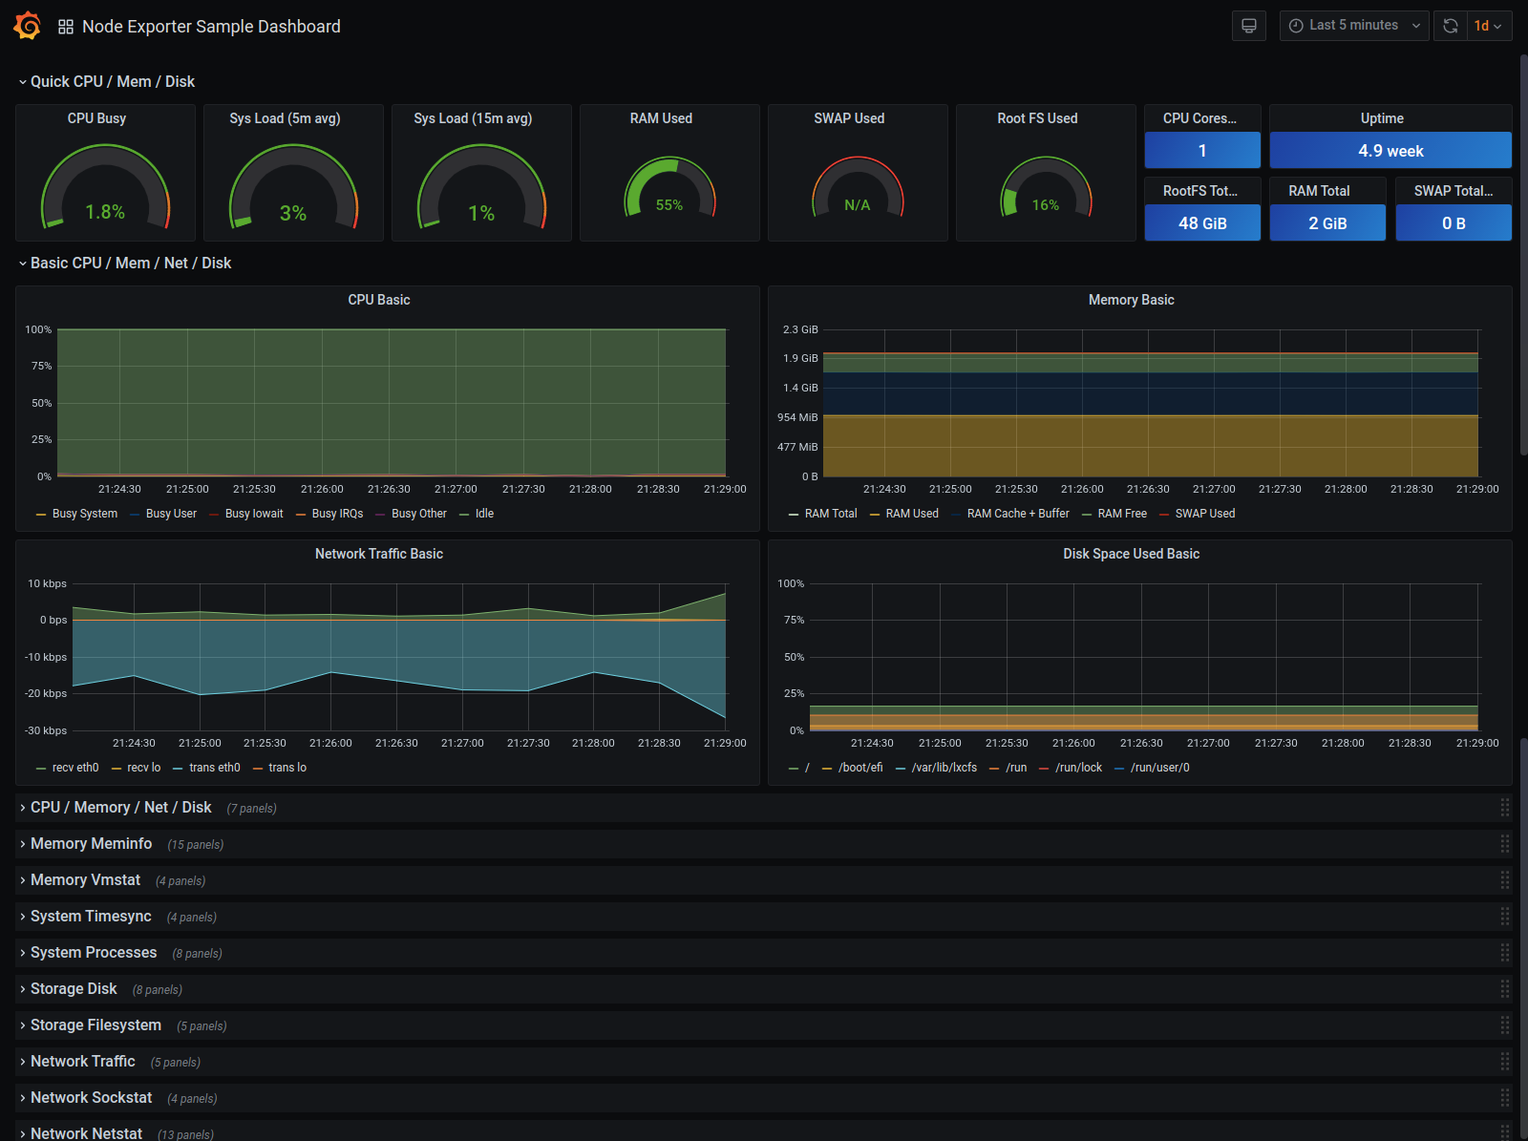

Slide 17
A Peek Into...
Prometheus UI

Slide 18


Any Questions

